Slide 1
CMPUT 206: Image Processing With Wavelets
Nilanjan Ray

Slide 2
Agenda
Wavelet transform in 2D
Explore some examples in Matlab
Image compression
Image de-noising
Image fusion

Slide 3
2D Wavelet Transform
1D wavelet transform can be extended toward 2D signals (i.e., images) in the following way
Treat rows of the image as 1D signals and apply 1D wavelet transform to them
Then apply 1D wavelet transforms to the columns of the transformed image
Thus, we obtain 3 channels corresponding to vertical, horizontal, and diagonal, and one approximation image
We can iterate the above procedure on the low pass channel
What if we reverse the order: column transform followed by row transform?

Slide 4
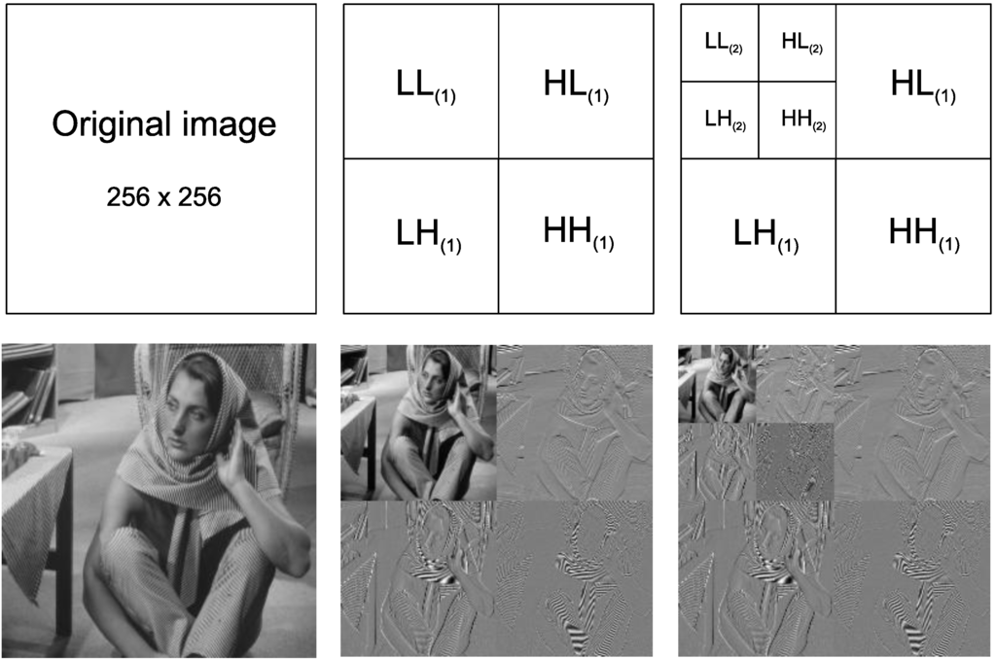
Wavelet Transform on Images
Original
Level 1
Level 2
L: trend coefficients
H: difference coefficients
Pay attention to the naming convention

Slide 5
Wavelet Transform on Images…
Level 1 wavelet transform
Level 2 wavelet transform
Input image
Use PyWavelets package:
https://pywavelets.readthedocs.io/en/latest/index.html

Slide 6
Wavelet-based Image Compression
We’d like to understand the basics
There are many zeros/near zero numbers in the difference coefficients
Make these small difference coefficients zeros
Instead of storing real numbers, should quantize them to save space
Need to store the quantized coefficients efficiently
JPEG2000 is based on these principles
For now, we will measure compression by % of zeros
Let’s try WaveAnalyzer in Matlab

Slide 7
Wavelet-based Image De-noising
Perform wavelet transform
Decide a threshold value t = s*sqrt(ln(M*N)), where M and N are respectively height and width of the image, s is noise standard deviation
There are two types of threshold: hard and soft applied on the difference coefficients
Hard threshold:
If abs(c)<=t, c=0; end
Soft threshold (aka wavelet shrinkage):
If abs(c)<=t, c=0; else, c = sign(c)(abs(c)-t); end
Next take inverse wavelet transform of the modified coefficients to obtain de-noised image
Let’s try WaveAnalyzer in Matlab

Slide 8
Image Fusion
Have wavelet decompositions of images
Combine trend coefficients by taking their mean
Combine difference coefficients by picking the one with the maximum absolute value
Take inverse wavelet transform to obtain the fusion
WaveAnalyzer demo in Matlab

